Slide 1
TO STUDY THE INTERFERENCE OF LIGHT BY NEWTON’S RING APPARATUS
AIM
To determine the wave length of sodium light by using Newton’s ring.
APPARATUS USED
Travelling microscope (for Newton’s ring), Sodium vapour lamp, A thin plano-convex lens of large focal length, A convex lens of short focus, an optically plane glass plate.

Slide 2
THEORY AND FORMULA USED
When a monochromatic parallel beam of light is incident on a thin air film enclosed between a plano-convex lens and a plane glass plate (shown in Figure), the two reflected rays – one from top and another from bottom surface of thin air film (ray 2 and ray 3 shown in Figure) will interfere. Ray 1 and ray 4 shown in Figure will not take part in interference due low coherency of the sodium light source. Around the point of contact, the points having equal thickness of air film lie on circles concentric with the point of contact. Hence due to interference between the two reflected rays a series of alternate dark and bright concentric rings will be produced. These are called Newton’s rings. The thickness of air film at the contact point is infinitesimally small. But due to phase change of π by reflection form rarer to denser medium (air to glass), the central ring will be dark.

Slide 3
THEORY AND FORMULA USED
The wavelength of sodium light which is used for the Newton’s ring setup is given by the formula:
where
λ = wavelength of sodium light
D_{n+m} = diameter of (n+m)th ring
D_{n} = diameter of nth ring
R = Radius of curvature of the convex surface of the plano-convex lens.

Slide 4
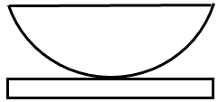
SCHEMATIC OF THE NEWTON’S RING SETUP
Microscope
Glass Plate (G₁)
Ray No. 2 & 3 will take part in Interference
1
2
3
Sodium Lamp
4
Convex Lens (L₁)
Plano Convex Lens (L₂)
Glass Plate (G₂)
Newton’s ring arrangement
Interference between light waves reflected from different surfaces of plano-convex lens and plane glass plate.

Slide 5
PROCEDURE
Open the given link in a window
http://lo-au.vlabs.ac.in/laser-optics/Newtons_Rings_Wavelength_of_light/experiment.html
2. Select the medium (air), light source (Sodium) and click the knob light ON .
3. Order no. of the rings can be varied by moving the knob of microscope position.
4. According to the theory, the center of the interference fringes should be dark.
5. Move the microscope in horizontal direction to the left side of the fringes. Fix up the cross- wire tangentially to the (n+m)^{th} bright ring and note down the readings of both the main scale and vernier scale. Then the microscope is moved in horizontal direction to the right side and should be fixed up tangentially to the successive bright fringes up to the 1st ring. Write down the readings of all successive rings. Then the microscope is moved to the right side of the fringes and should be fixed up tangentially to the 1st bright fringe. Write down the readings of both scales. In this way, all the readings of successive bright fringes should be noted down up to (n+m)^{th} bright ring.

Slide 6
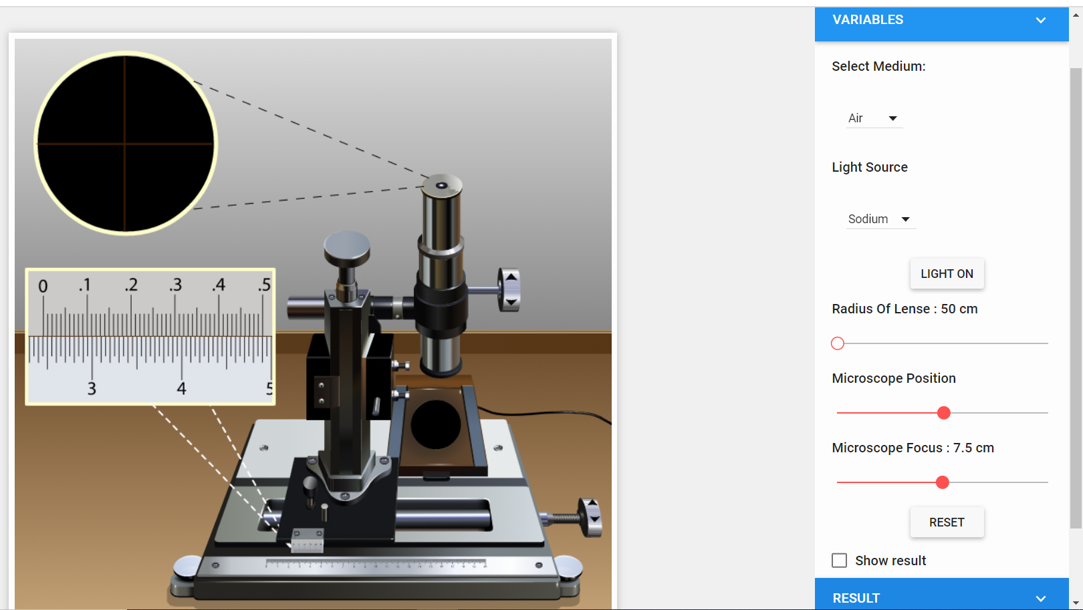
NEWTON’S RING SETUP (VIRTUAL)
Link : http://lo-au.vlabs.ac.in/laser-optics/Newtons_Rings_Wavelength_of_light/experiment.html
Select
Select
Click

Slide 7
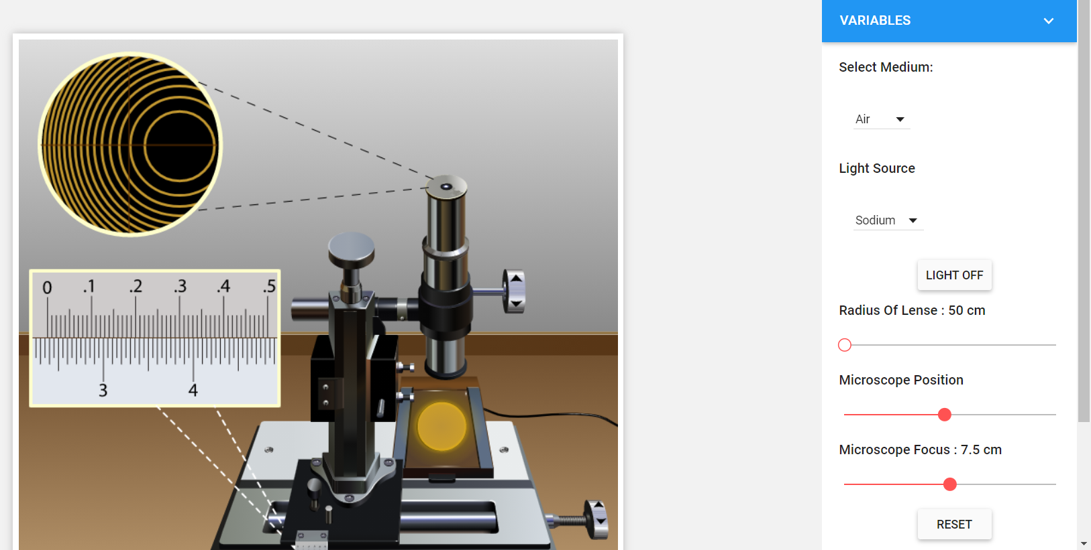
NEWTON’S RING SETUP (VIRTUAL)
Select the order no. of the ring by varying the microscope position
Vary Microscope position
Note down the reading from the scale bar

Slide 8
OBSERVATIONS
(A) Radius of the plano-convex lens, R= …….. cm (note down from the reading)
(B) Find the vernier constant of microscope :
(C) Determination of Diameter of the Newton’s rings
Table - I
Obs. No. | Ring No. n | Microscope Reading (in cm) |  |  |  |  |  | Diameter of the rings, D = L_{T} ̴ R_{T} ₍cm)
 |  | L.H.S reading |  |  | R.H.S reading
 |  | MSR | VSR | TOTAL (L_{T}) | MSR | VSR | TOTAL (R_{T})
1.
2.
3.
4.
5.

Slide 9
OBSERVATIONS
Table - II
Ring No. n | Diameter D_{n} | (cm²) | (cm²) | Mean cm²
1.
2.
3.
4.
5.

Slide 10
CALCULATIONS
RESULT
The wavelength of the sodium light is ………….. Ǻ
PRECAUTIONS
The plano‐convex lens should be of large radius of curvature.
The microscope is always moved in the same direction to avoid back lash error.
Here in virtual platform we are setting are crosswire on a bright ring but in physical experimental setup crosswire should be focused on a dark ring tangentially.
References
http://lo-au.vlabs.ac.in/laser-optics/Newtons_Rings_Wavelength_of_light/experiment.html

